Slide 1
Education Project
Anh Huy Ha (C-AnhHH) Ho Minh (Minhh1)

Slide 2
Introduction
Evaluate class quality based on teacher, student, subject information, grades, and feedbacks.
The performance will be evaluated based on Student course evaluations at the end of the courses such as the rating of the classes, rating of the instructors, recommendations by students, and final scores grades of students.

Slide 3
New Feature
Parameters and Variables on SSIS
Data Profiling and audits files
Load via Rest API Python / ODBC
Send Mail Task
Deploy in MSSQL ( Allert , Schedule , Environment )
SSIS Catalog
Stream / Task - Security - Handling Failure - Snowflake
Tool tip in Dashboard
Change top Highest to Lowest, Tooltips - Dashboard Power PI
Schedule - refresh Dataset Services

Slide 4
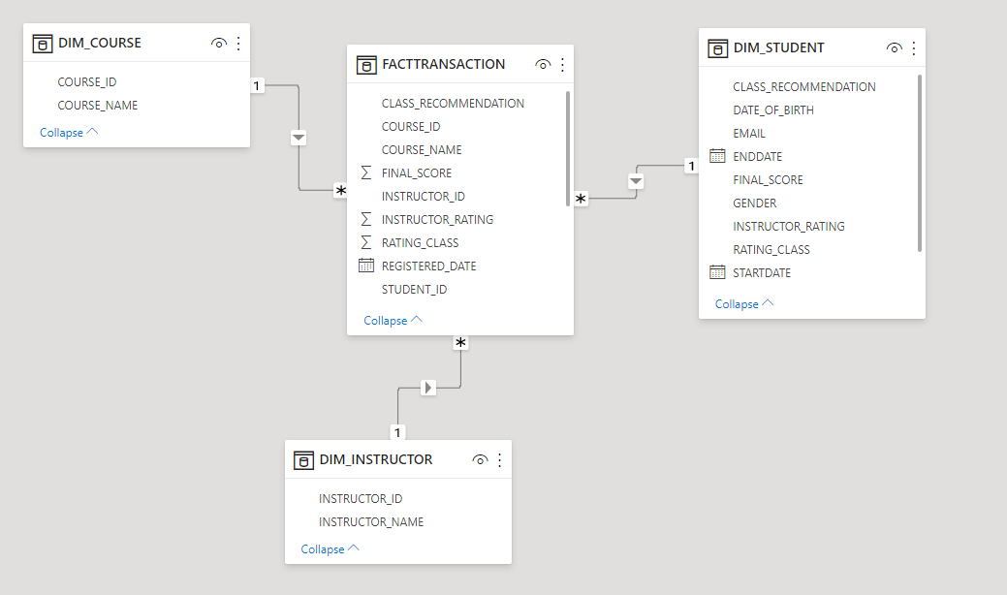
Model Schema

Slide 5
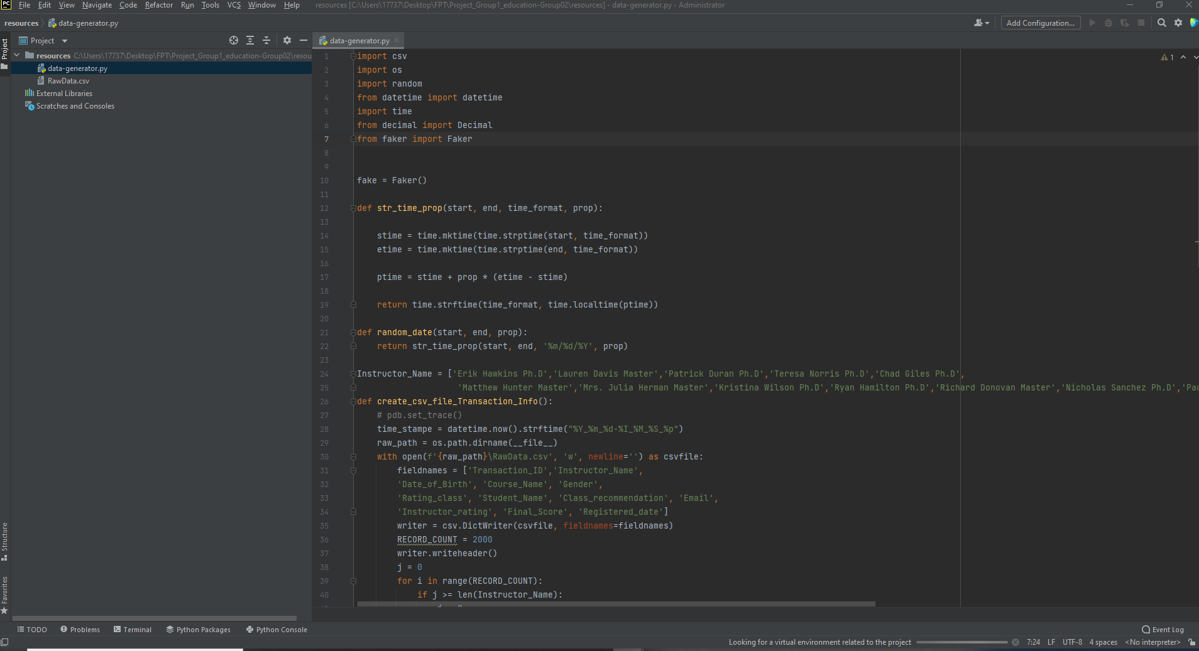
Python

Slide 6
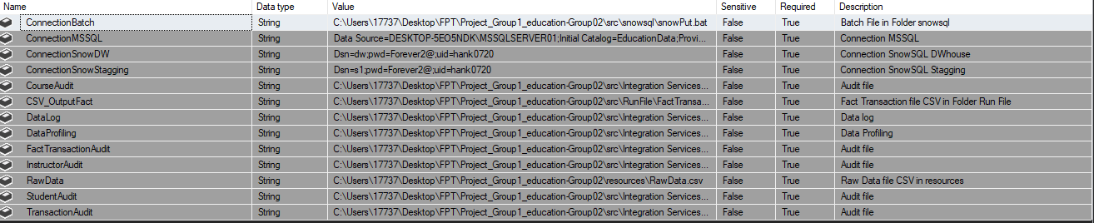
SSIS Parameters

Slide 7
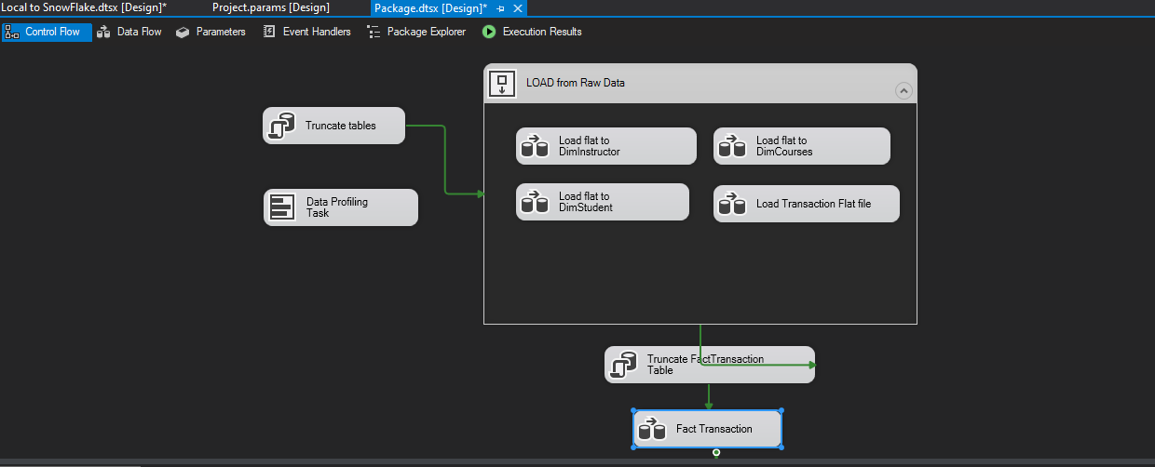
SSIS Load Raw File To MSSQL

Slide 8
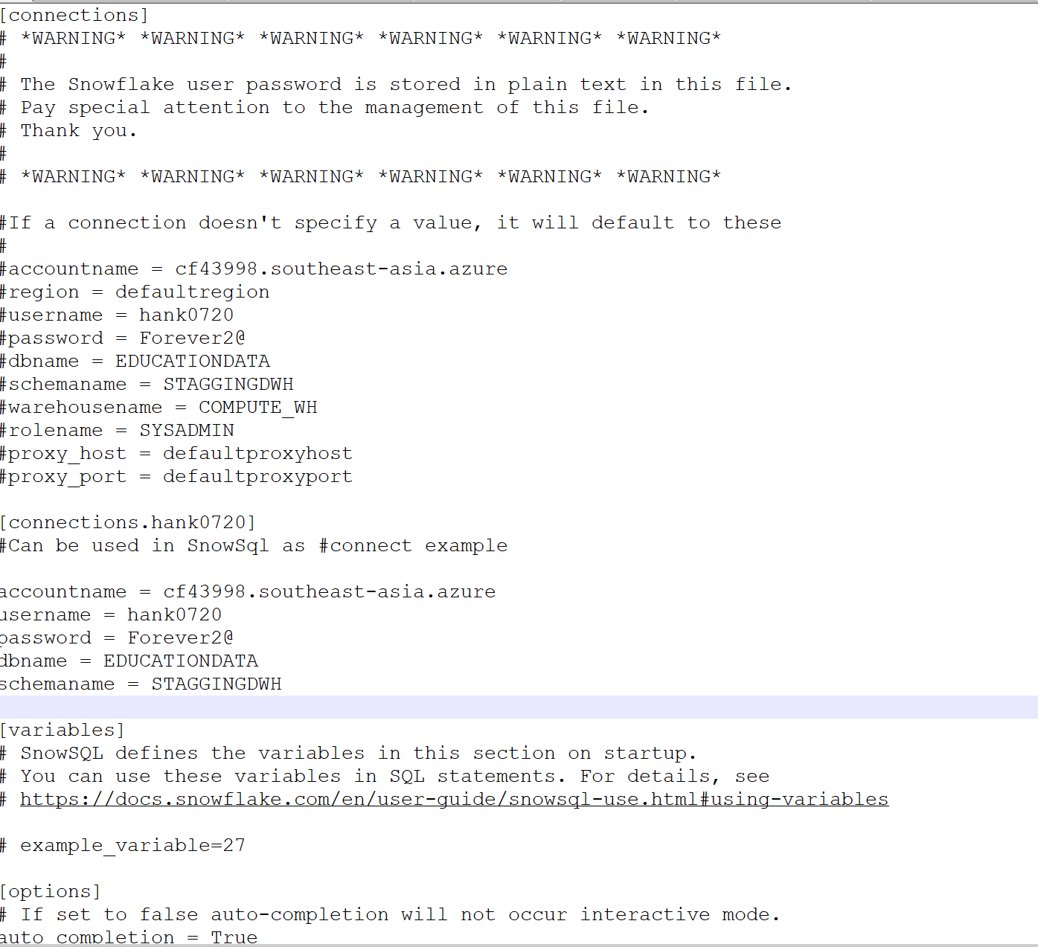
Configuration
Step 1: Config connection Snowflake
Path to config: C:\Users\Admin\.snowsql

Slide 9
Configuration
Step 2: Edit file file bat in folder snowsql
-c : connection string SNOWFLAKE hank0720
-f : file ssis Put in folder Run file ( change path file suitable with yours )

Slide 10
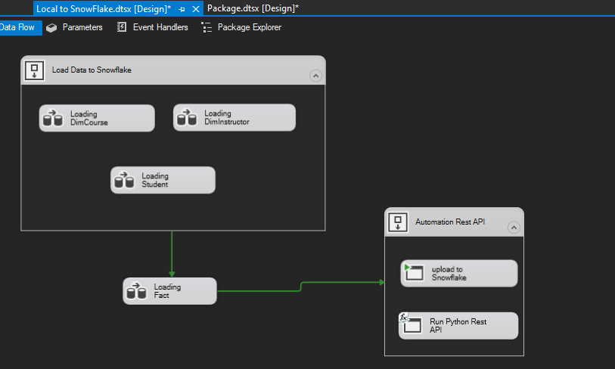
SSIS Local to SnowFlake

Slide 11
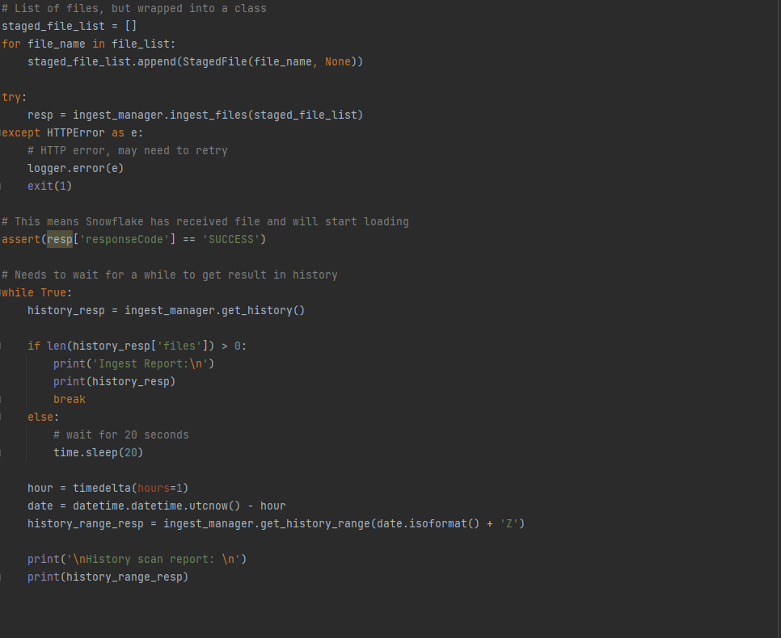
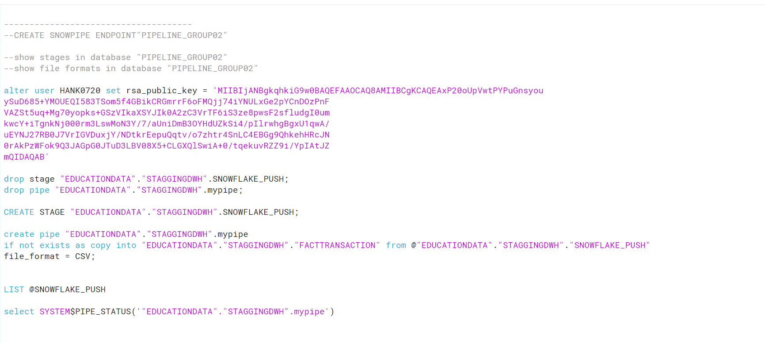
Rest API Snowflake

Slide 12
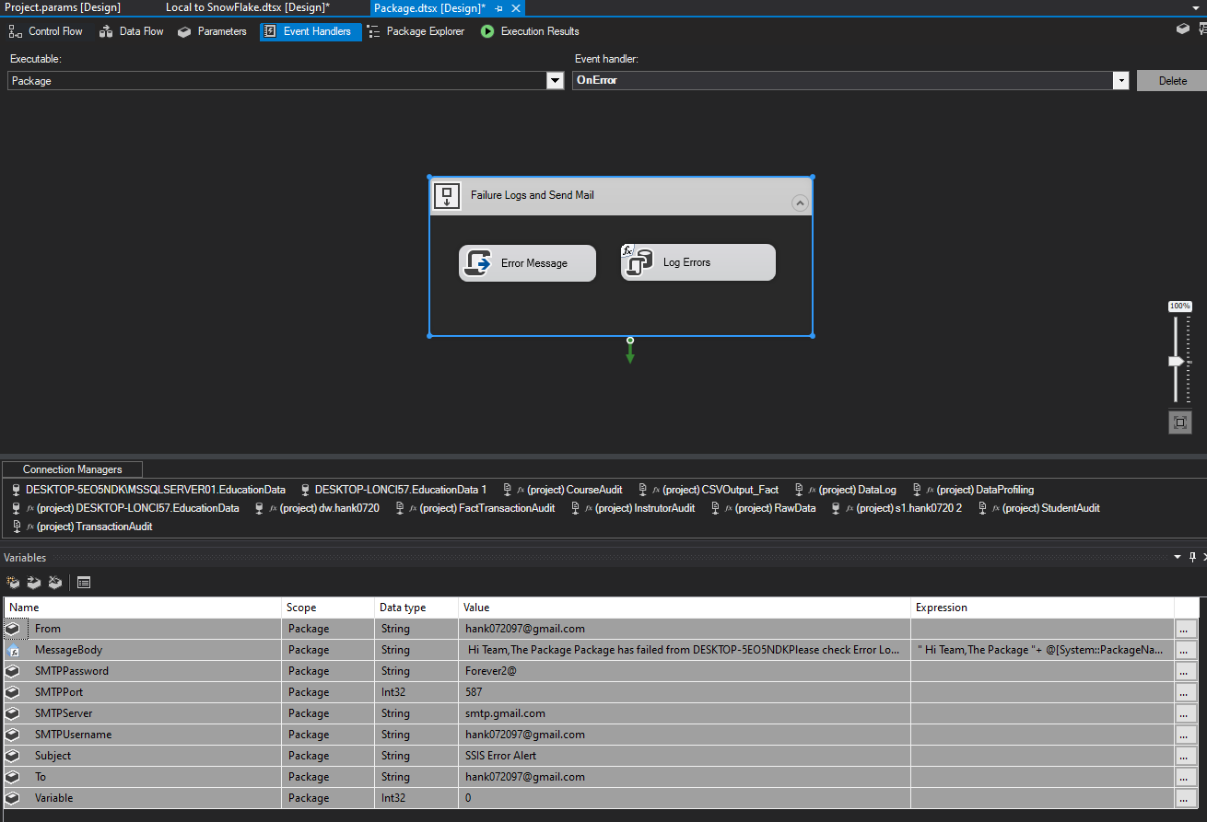
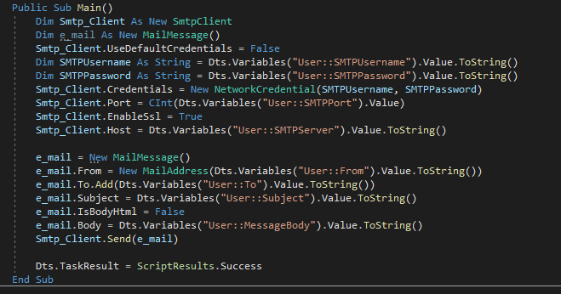
SSIS Event Handler

Slide 13
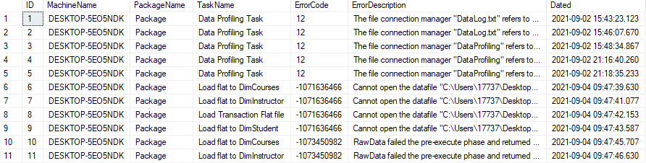
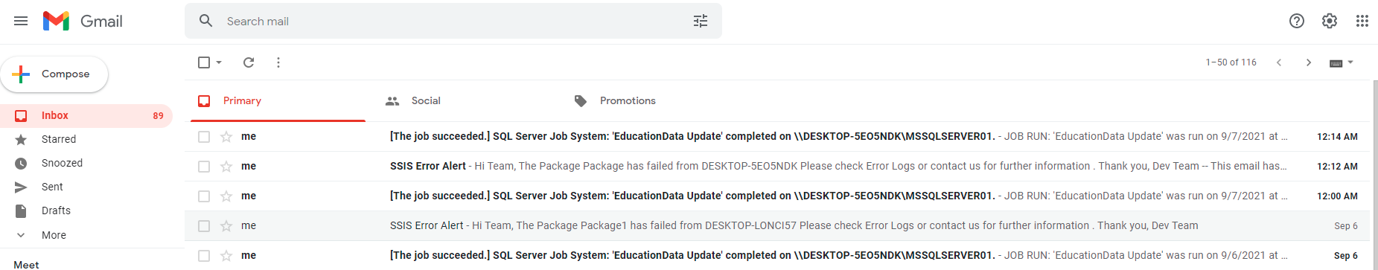
SSIS Error Logs and Email

Slide 14
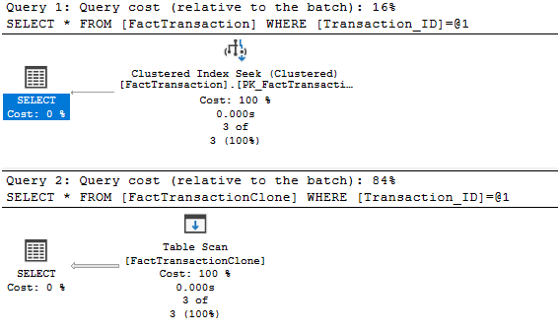
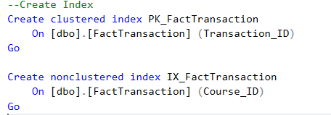
MSSQL Index

Slide 15
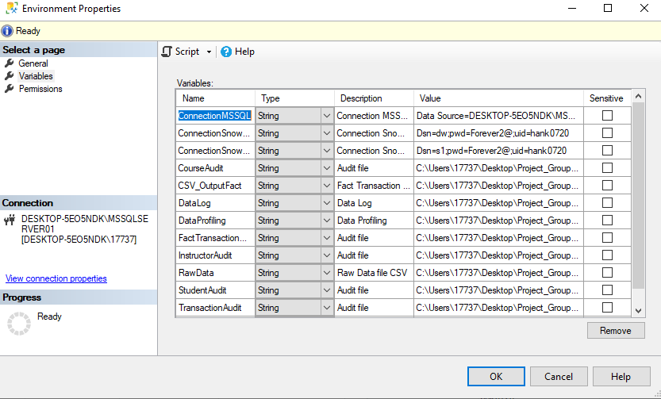
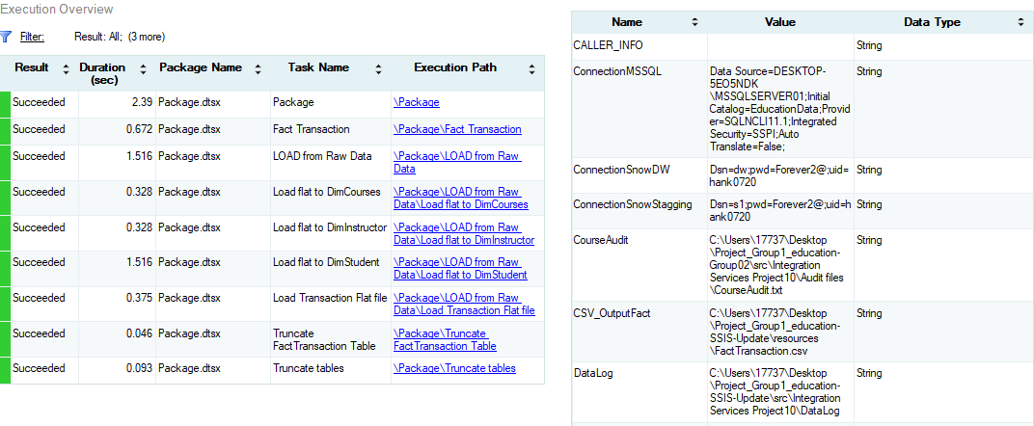
MSSQL Deploy Package on SSIS Catalog

Slide 16
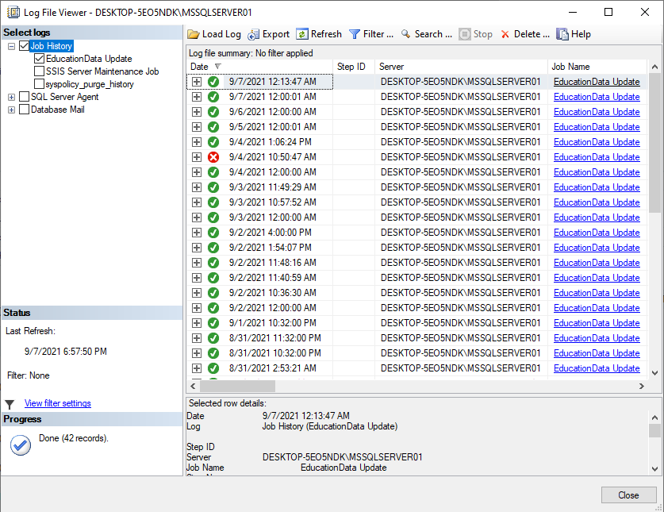
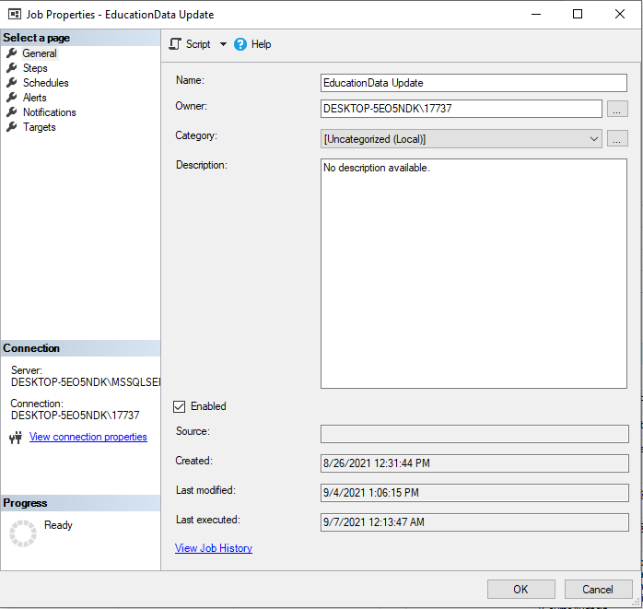
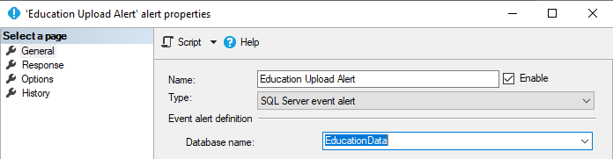
MSSQL Jobs, Alert and Schedule

Slide 17
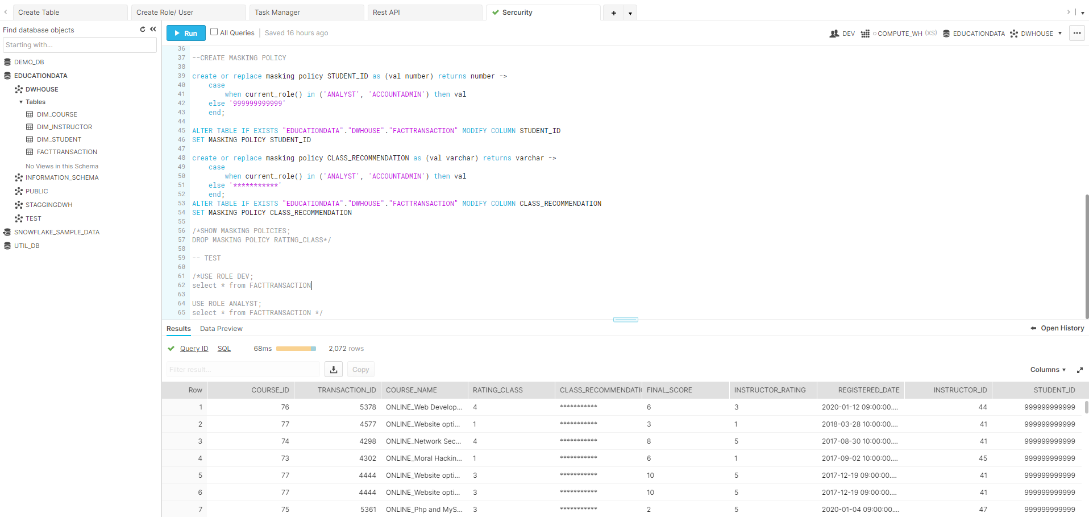
SnowFlake Create Tables, Roles, Users and Security

Slide 18
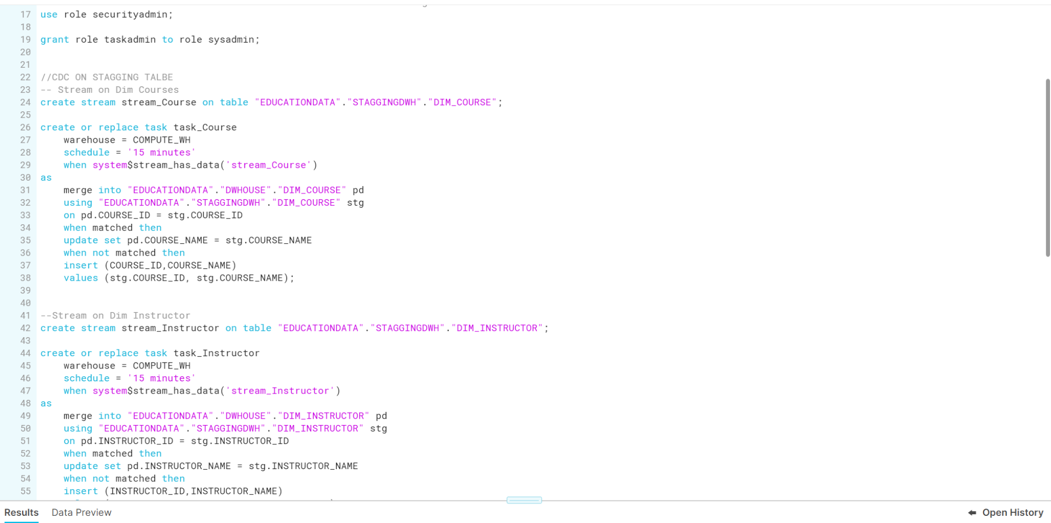
Stream Task Manager

Slide 19
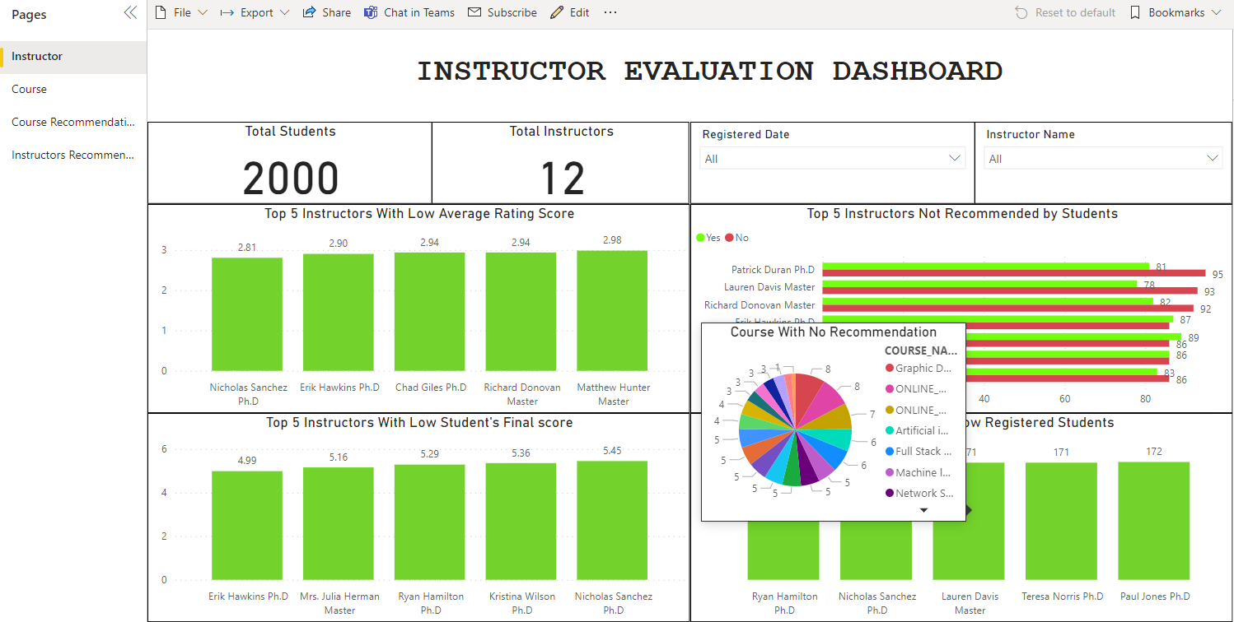
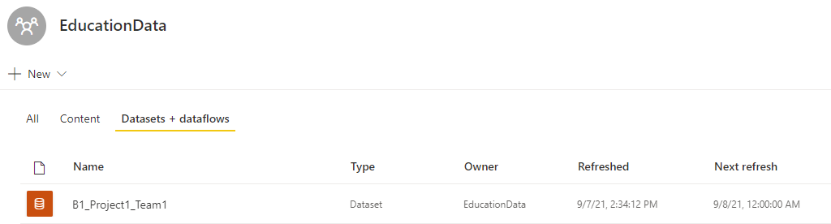
PBI Dashboard and Refresh Data

Slide 20
Thank You For Joining Today!

